Slide 1
McDonald’s Review Sentiment Analysis
Carissa Hicks
May 2025

Slide 2
Project Overview
GOAL: Understand the sentiment around McDonald’s services, products, and locations to improve customer experience
Sentiment analysis of customer reviews from 11 states, 26 cities
Data: https://www.kaggle.com/datasets/nelgiriyewithana/mcdonalds-store-reviews/data

Slide 3
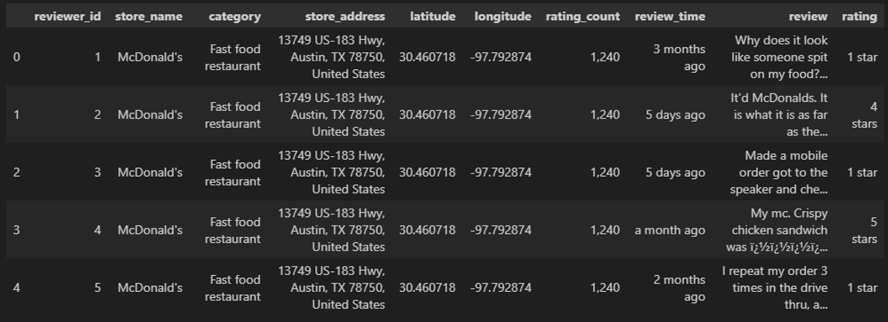
Raw Data Example
Removed: reviewer_id, store_name, category, latitude, longitude, rating count
Review column cleaned using NLTK
manual_sentiment added based off star rating
Store_address expanded to separate city, state, and zip columns
review_period added based on review_time
manual_topics added based on review text

Slide 4
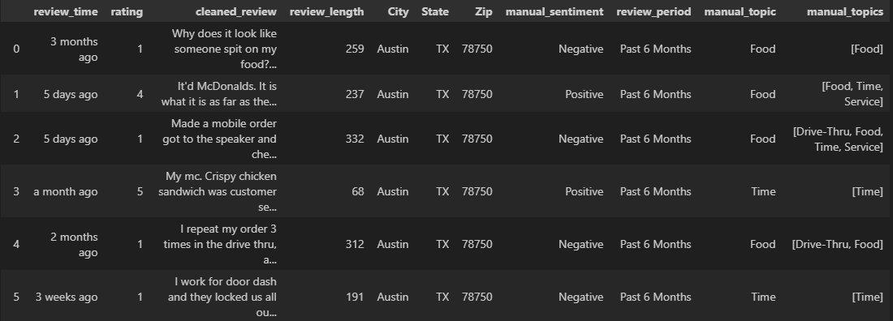
Cleaned Data

Slide 5
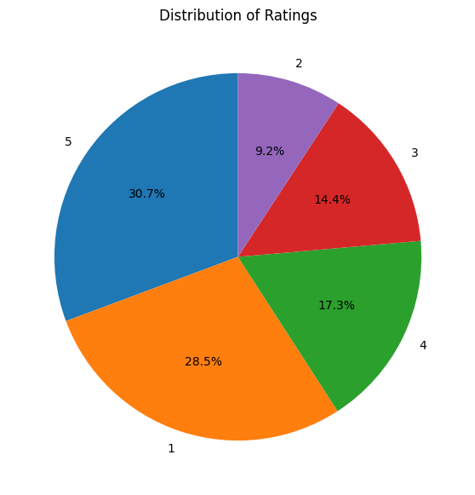
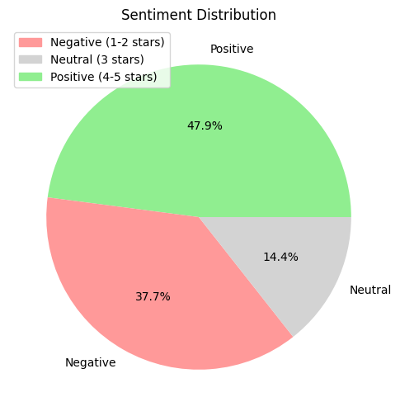
Distribution of Ratings and Sentiment
Positive: 4-5 stars
Neutral: 3 stars
Negative: 1-2 stars

Slide 6
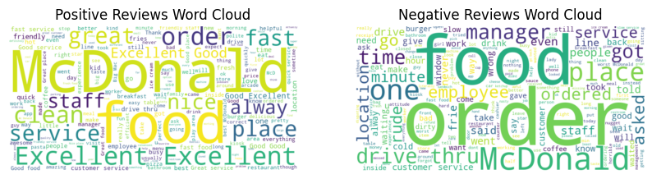
Word Clouds

Slide 7
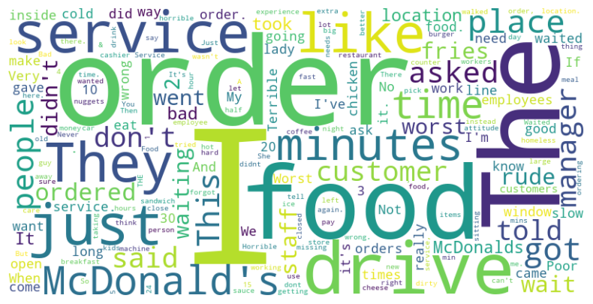
Most Common Words In Reviews

Slide 8
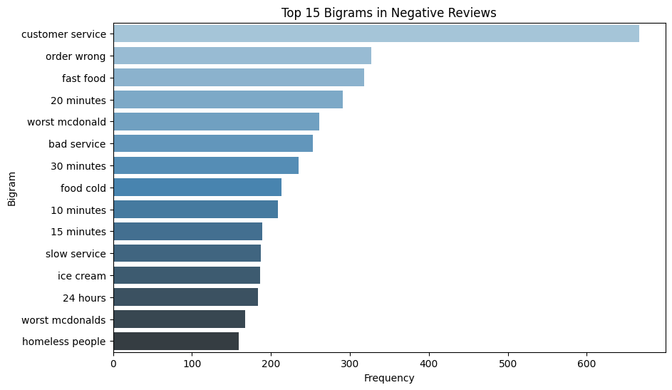
Top 15 Bigrams in Negative Reviews

Slide 9
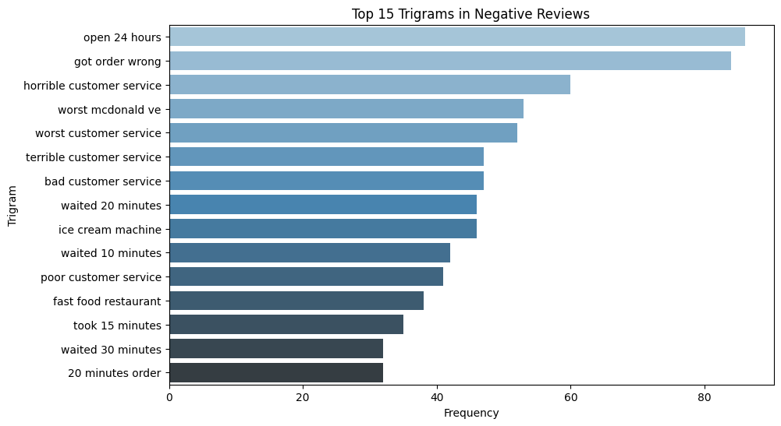
Top 15 Trigrams in Negative Reviews

Slide 10
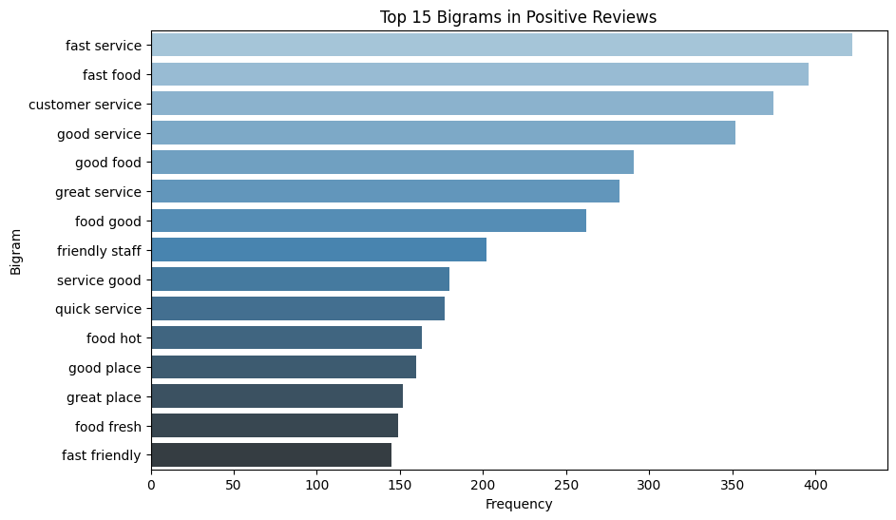
Top 15 Bigrams in Positive Reviews

Slide 11
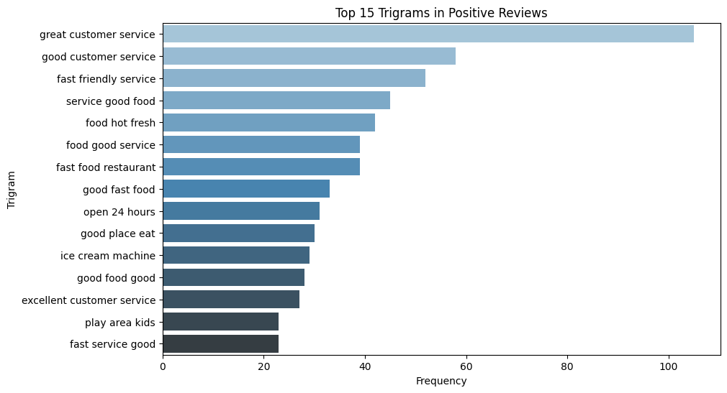
Top 15 Trigrams in Positive Reviews

Slide 12
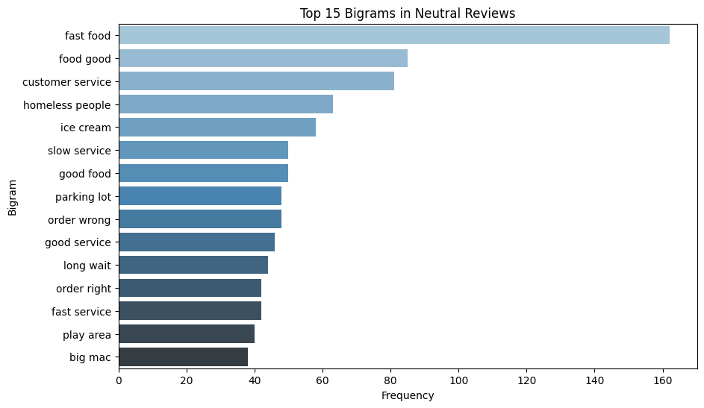
Top 15 Bigrams in Neutral Reviews

Slide 13
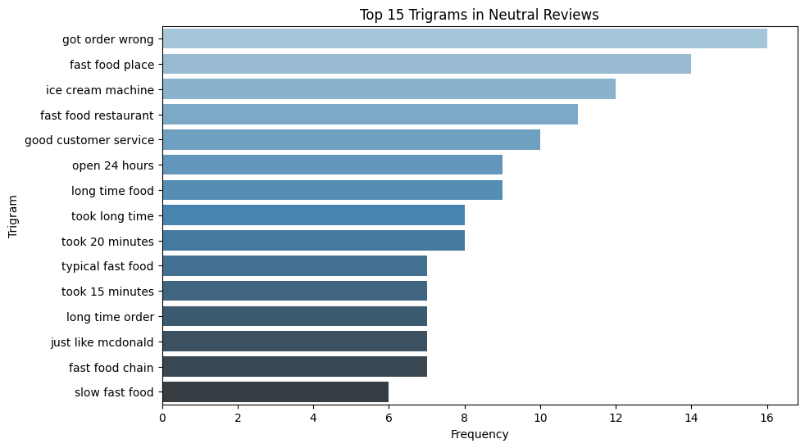
Top 15 Trigrams in Neutral Reviews

Slide 14
Key Insights
Negative Reviews talk about the quality of customer service, time waiting for food, homeless in the area, and the ice cream machine.
Positive Reviews talk about the quality of customer service, time waiting for food, and quality of food
Neutral Reviews talk about getting their order wrong, the ice cream machine, time waiting for food, and homeless in the area.

Slide 15
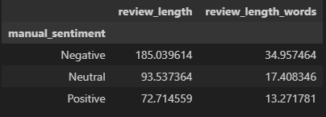
Character and Word Lengths
Negative reviews are on average twice as long as Neutral and Positive reviews.

Slide 16
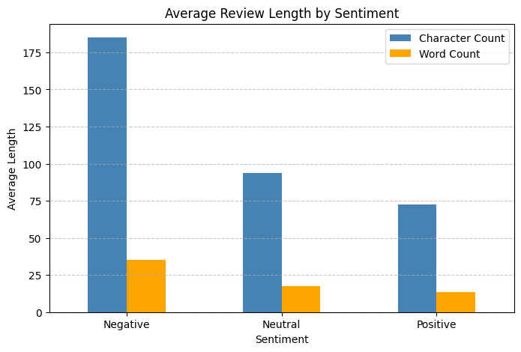
Average Review Length By Sentiment

Slide 17
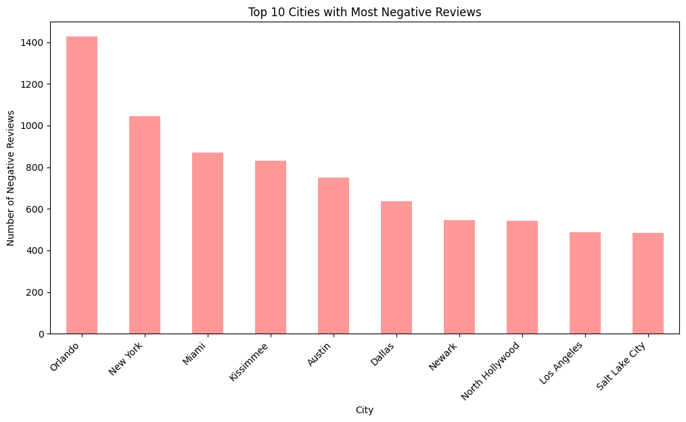
Top 10 Cities with Most Negative Reviews

Slide 18
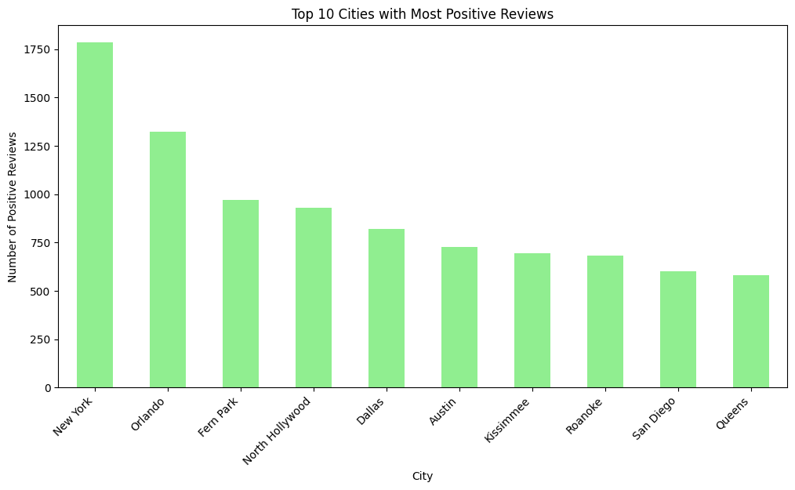
Top 10 Cities with Most Positive Reviews

Slide 19
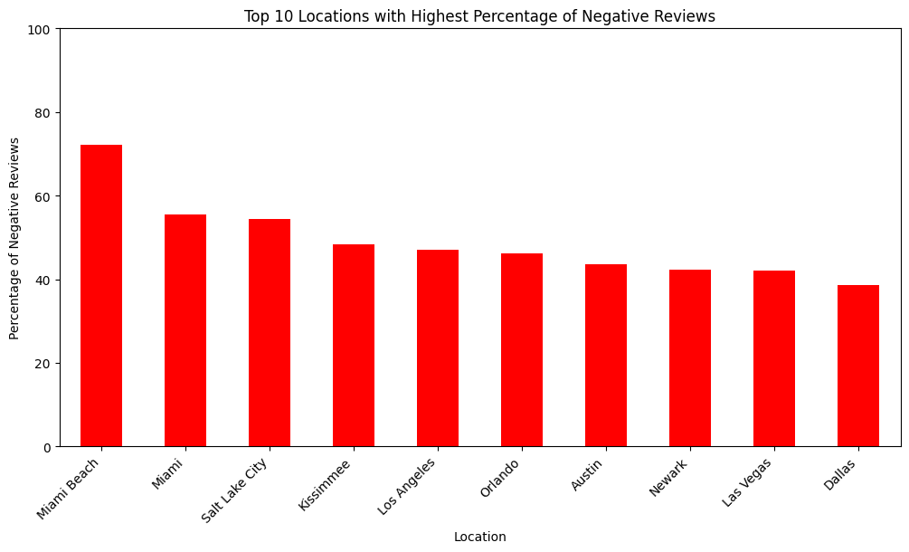
Top 10 Locations with Highest Percentage of Negative Reviews

Slide 20
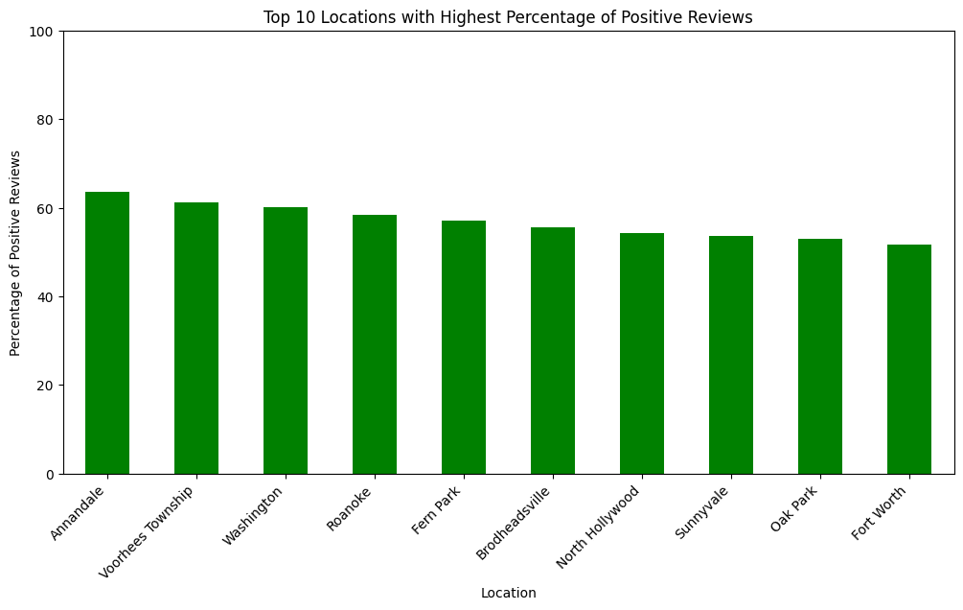
Top 10 Locations with Highest Percentage of Positive Reviews

Slide 21
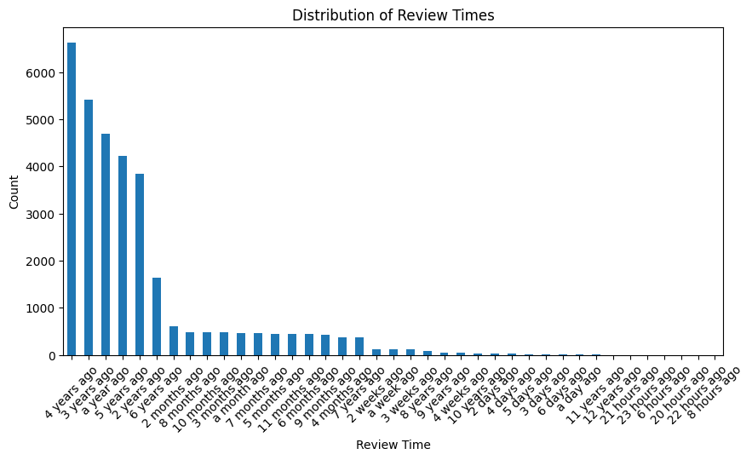
Distribution of Review Times

Slide 22
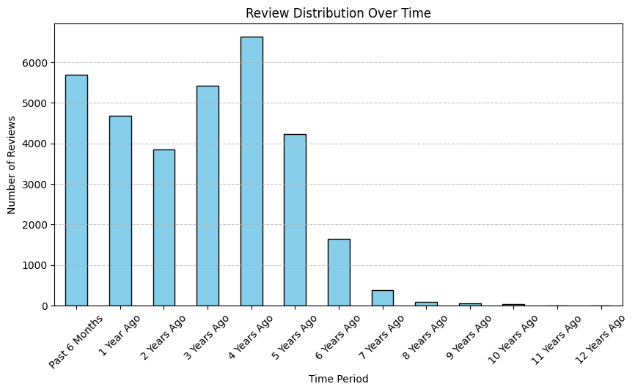
Review Distribution over Time (Review Period)

Slide 23
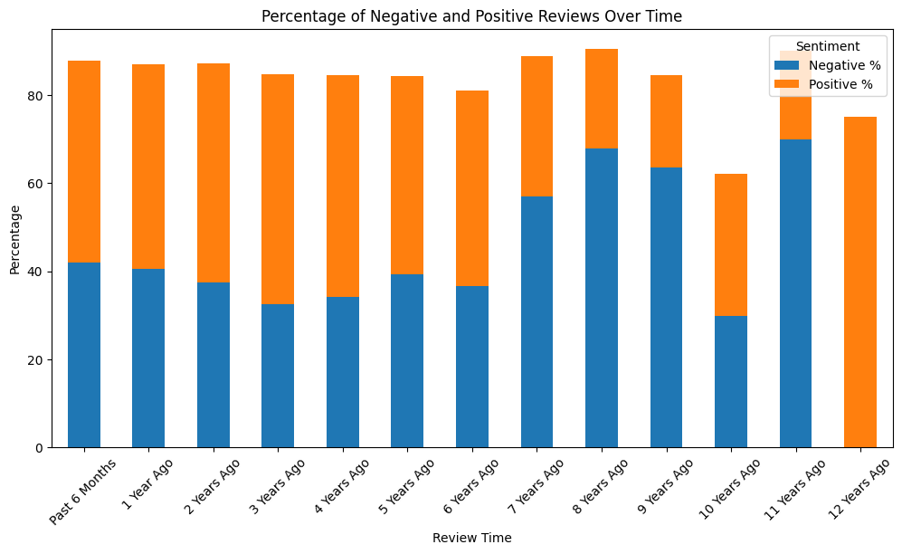
Percentage of Negative and Positive Reviews Over Time

Slide 24
Mapping Manual Topics
Reviews containing words in the related topic got a tag, and “other” if it contained none of them
Food: "order", "food", "cold", "hot", "raw", "undercooked", "burnt", "wrong item“
Service: "manager", "staff", "rude", "friendly", "attitude", "helpful", "people", "ice cream“
Time: "wait", "long", "slow", "line", "minutes", "fast", "quick“
Drive-Thru: "drive thru", "drive-thru", "window", "speaker", "order box“
Amenities: "bathroom", "restroom", "toilet", "play area", "kids area", "dirty", "clean", "table", "floor"

Slide 25
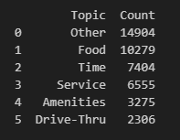
Distribution of Reviews in Topics
Manual topics were mapped based on the bigrams and trigrams of frequent words seen in reviews.
Most reviews dealt with food, time, and service.

Slide 26
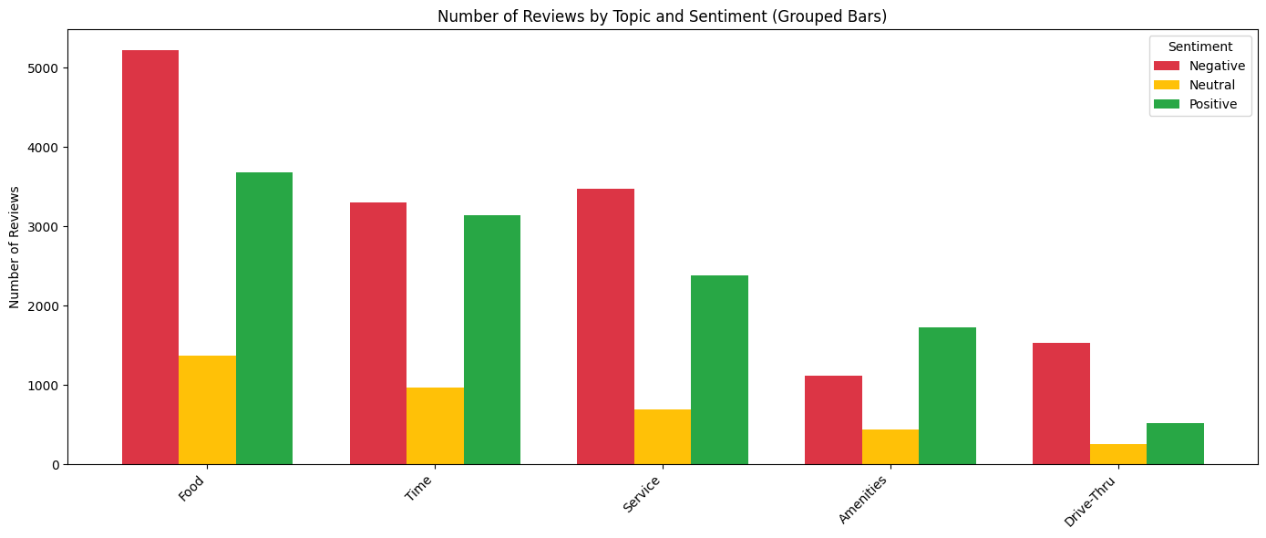
Reviews by Topic and Sentiment

Slide 27
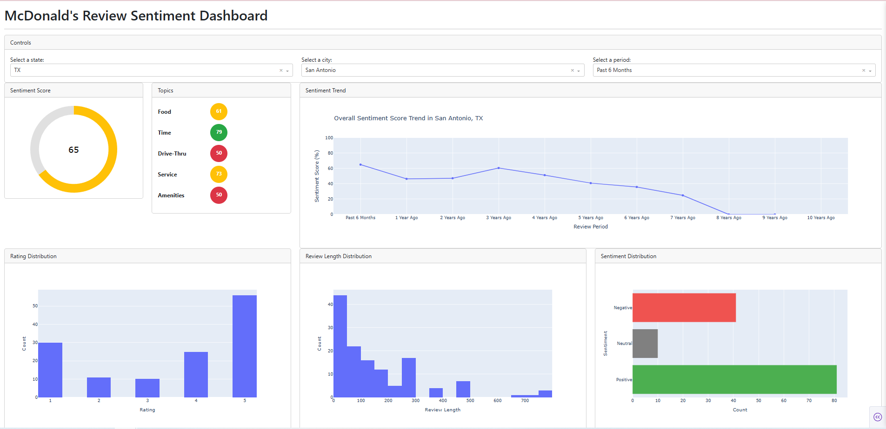
Dashboard for Individual City and State Analysis

Slide 28
Use the controls section dropdowns to select a state, city, and time period

Slide 29
Visualizations will update based on your selections

Slide 30
Sentiment Score trend graph will only update with State and City

Slide 31
Sentiment Score will change color based on its score. Red, yellow, or Green

Slide 32
Sentiment Score is calculated based on the formula:
Negative is scored as 0 points
Neutral is scored as 1 point
Positive is scored as 2 points
Final Score = Total Points Scored / Maximum Possible Points

Slide 33
Final Thoughts
Overall sentiment has remained the same negative/positive split over the past 5 years
While most reviews are positive, negative feedback (wait times, order accuracy, customer service) have also remained consistent
High Variance between cities – suggesting management or staffing differences are a key factor
Interesting Insights: Negative review customers complain of the ice cream machine being broken frequently and of concerns about safety and cleanliness due to homeless in the area

